Slide 1
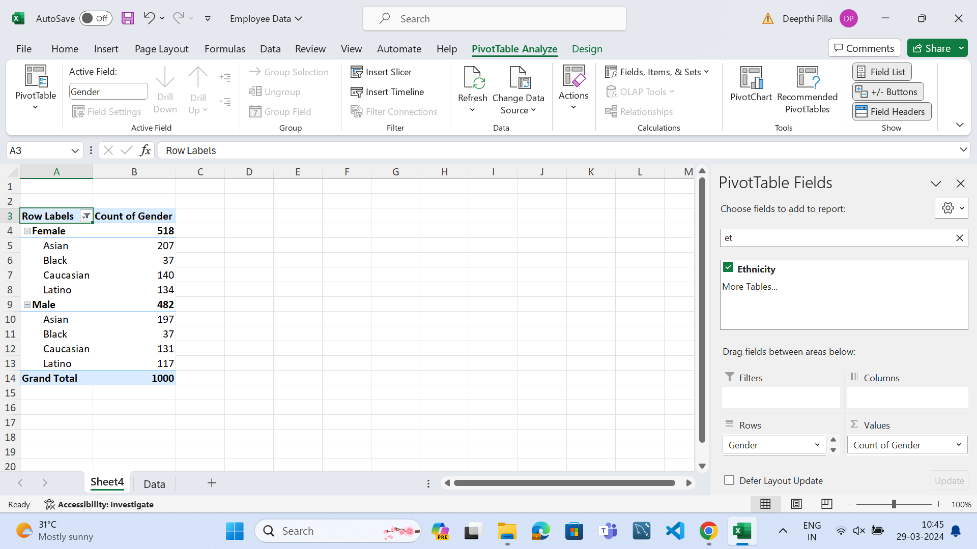
q1)Gender and ethnicity distribution
I have observed 518 females and 482 males and I have observed different distribution of it in different ethnicity

Slide 2
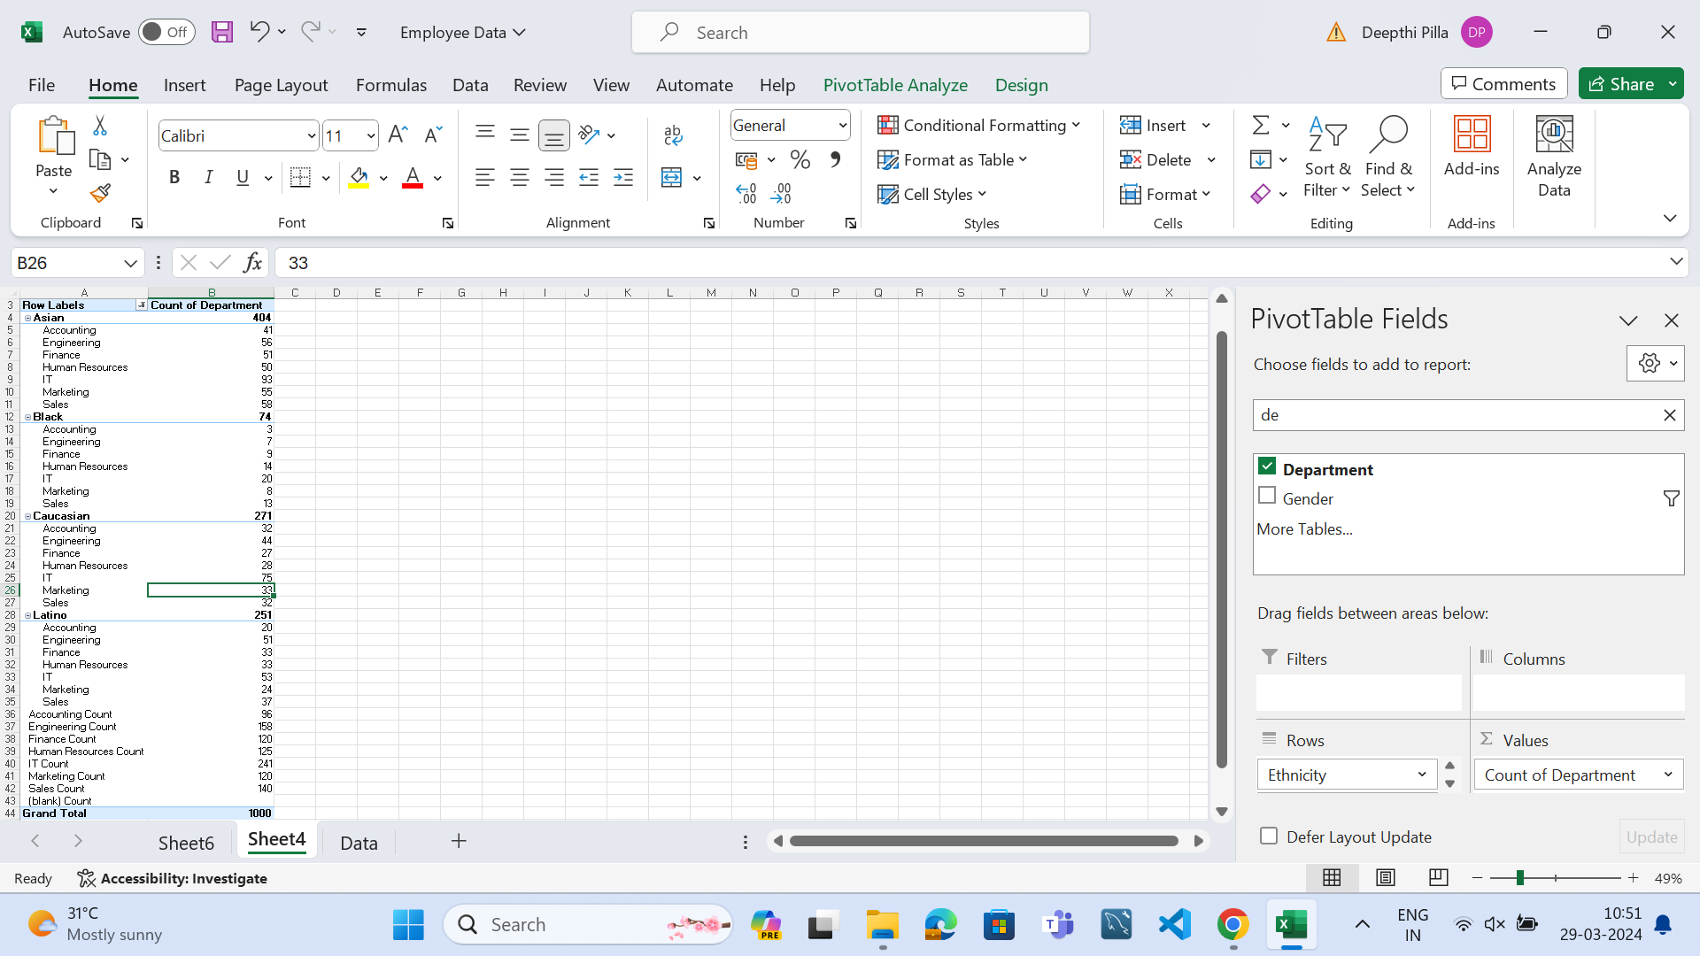
Q9)department diversity interms of ethnicity
I have observed number of employees in different departments according to ethnicity

Slide 3
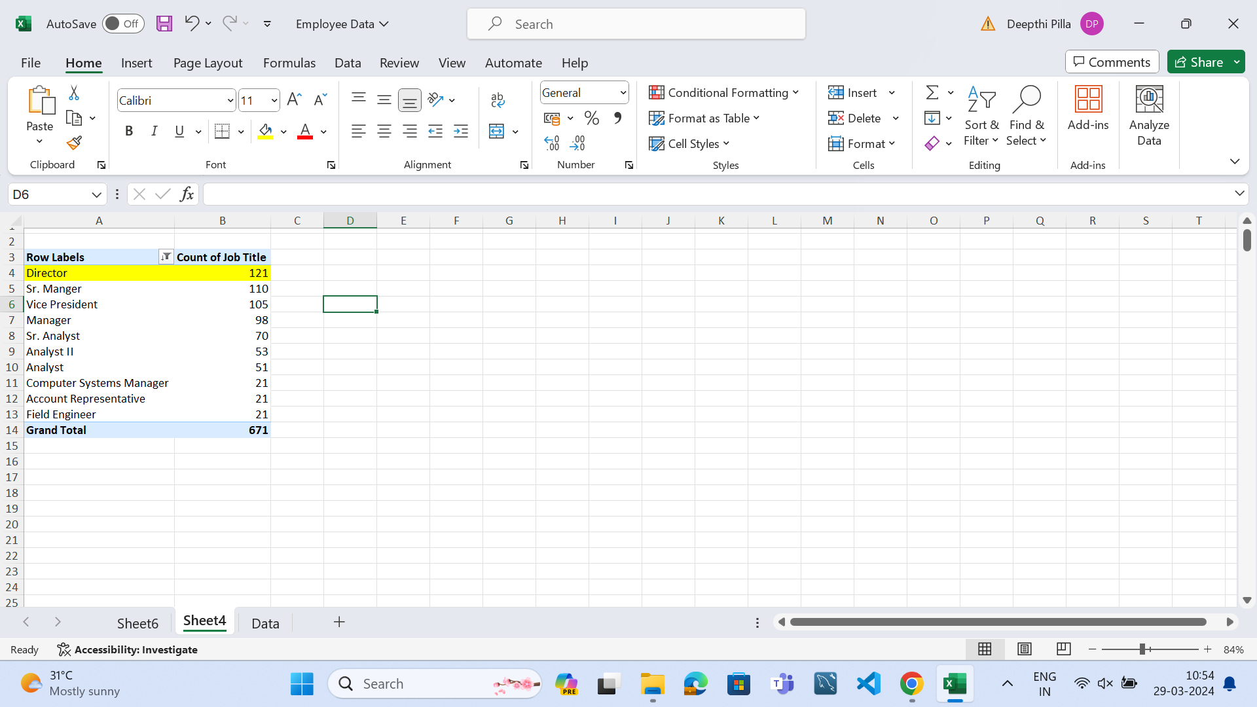
Q7)job title frequency
I have how many number of employees are there in the company
With same job title

Slide 4
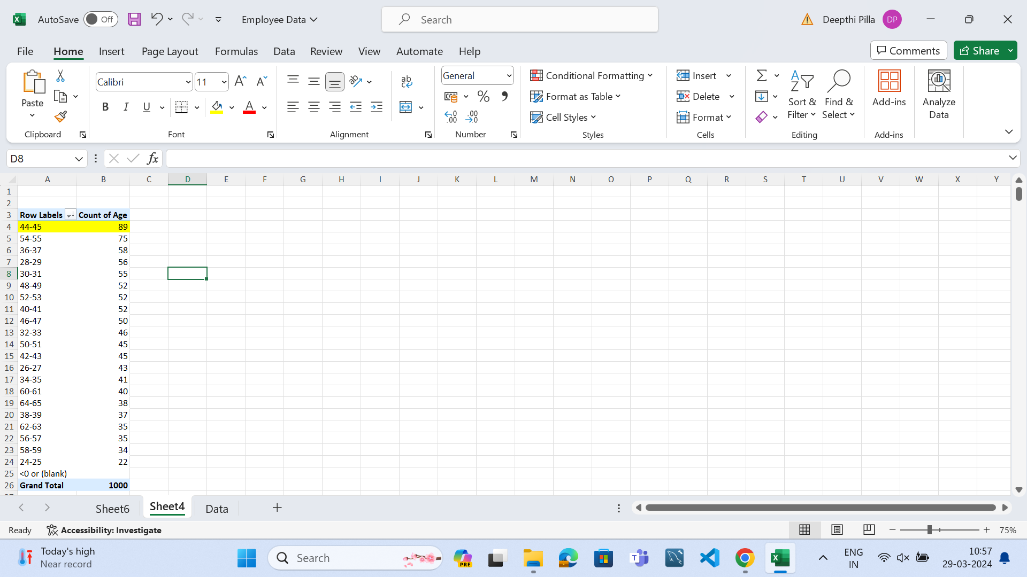
Q5)most common age range among employees
I have observed the most common age group of employees
Which is 44-45yrs

Slide 5
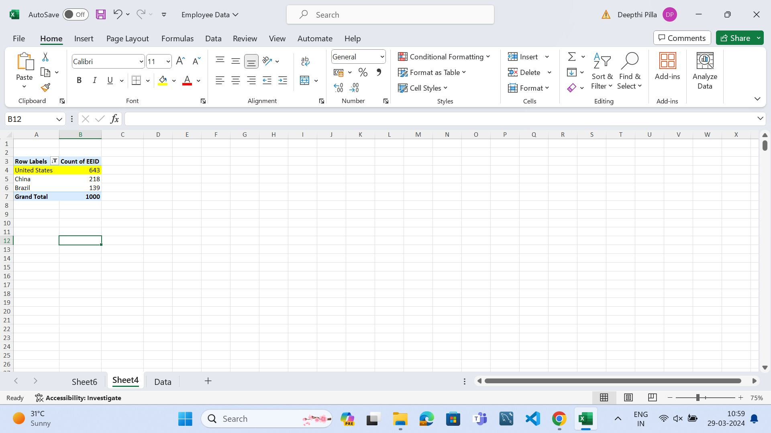
Q4)which country has highest number of employees
I have observed that united states is the country with highest
Number of employees

Slide 6
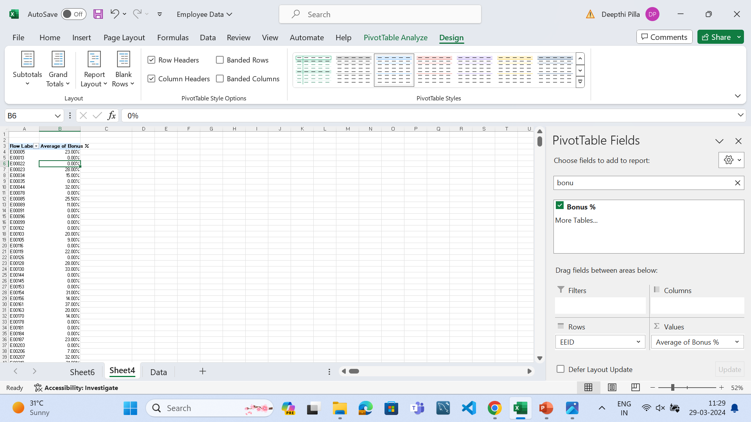
Q6)average bonus percentage to employees
I have observed average bonus
Percentage given to each employee
And also the total average bonus
Percentage given to employees is
8.87%
I have observed the average bonus percentage given
To the employees

Slide 7
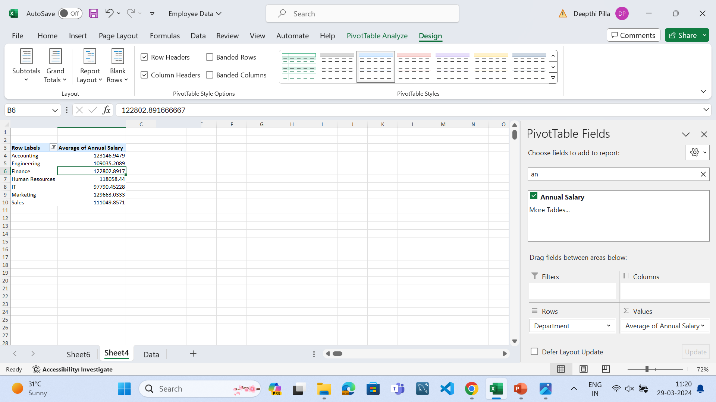
Q3)significant difference in average salaries of different departments
I have observed a significant
Difference in average salaries
For departments human resources
And IT department

